Slide 1
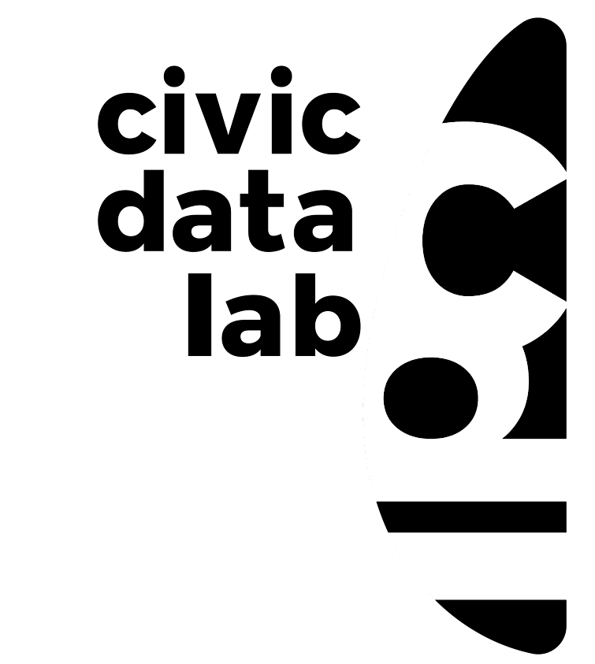
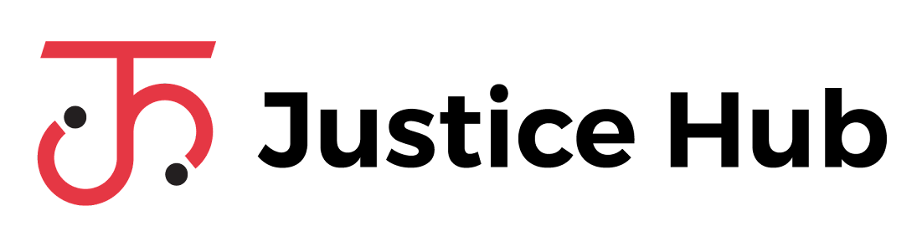
Datafication of Indian judicial texts using Natural Language Processing (NLP)
An Experiment using opennyai on pocso cases
Sai Krishna Dammalapati
13th May, 2023
/begin

Slide 2
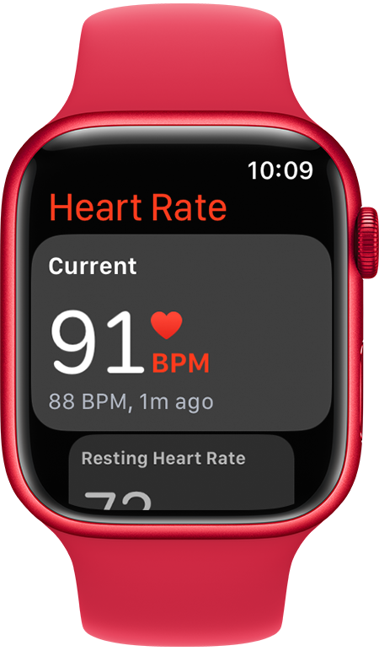
DAtafication?
Unstructured data
Structured data
Decision making
Helps one plan fitness routine
Helps to monitor cardiac health
Helps in emergency interventions

Slide 3

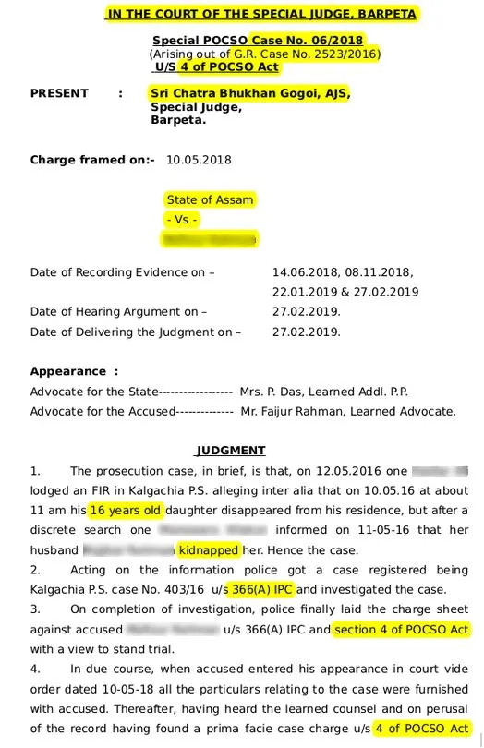

SMART WATch for legal-judicial data?
Unstructured data
Structured data
Decision making
How to create structured datasets beyond manual data-entry operations?
How can we aid lawyers, researchers, judges, governments etc., with this data?

Slide 4
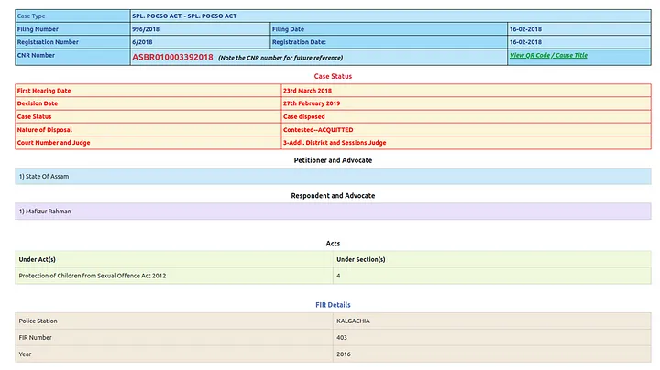

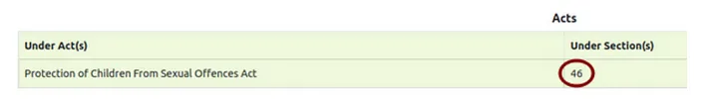
Present state of official metadata
Manual data entry on e-courts portal that is not exhaustive and error prone

Slide 5




NLP as the smart watch!
Unstructured data
Structured data
Decision making
Identifying variables using
Academic studies
Eg: Court name, Reference to bail etc.
LegalTech applications
Named Entity Recognition (NER)
Eg: IPC Statutes and Sections, Judge and Petitioner names, etc.
Lawyers’ assistance
Policy reforms
Eg: Age of the victim, relationship between perpetrator and victim

Slide 6


Pocso x OPENNYAI experiment
Objective: To check if OpenNyAI can find ‘relevant’** POCSO sections in a judgment exhaustively
Assam
2017-19
Dominant case types (Special (POCSO) Case, POCSO Act)
Identification of ‘relevant’ POCSO Sections in each judgment
Experiment results:
1. Metadata captured all relevant POCSO sections for only 28/51 judgements
2. In 20/51 judgements, we found a more exhaustive list of ‘relevant’ POCSO sections
3. There are data entry mistakes in 3/51 judgements’ metadata
51
1764
POCSO judgments*
672
Barpeta
Sonitpur
Dhubri
Sivasagar
* Disposed judgments only
** Relevance: POCSO Sections only mentioned in the “preamble” and “decision” part of the judgment

Slide 7
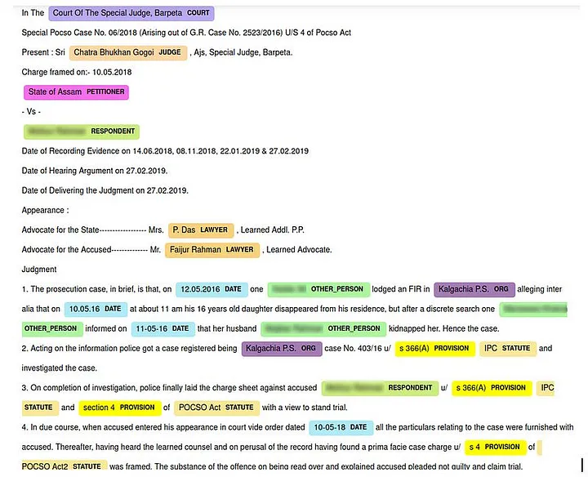
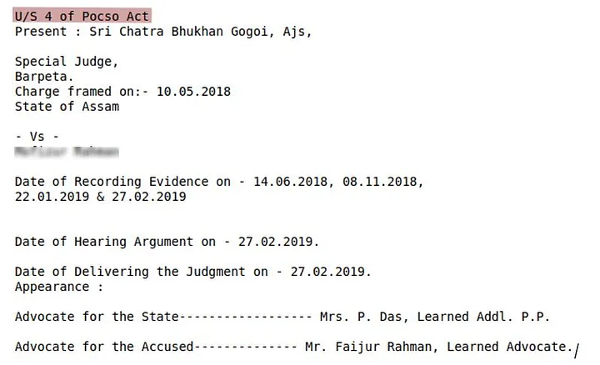
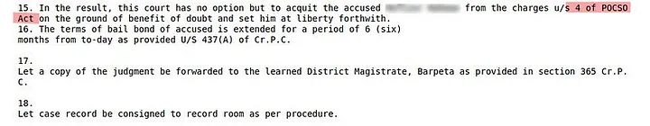
OPENNYAI screenshots
NER identification
“Preamble” summary
“Decision” summary

Slide 8






We are creating a CHILD rights data ecosystem
There is a lack of accessible disaggregated data on offences against children
Number of cases to be DATAFIED*
Raw dataset of case level indicators for all states
The Prohibition of Child Marriage Act, 2006
17,554
Processed datasets of case level indicators for selected states
The Prohibition of Child Marriage Act, 2006
The Protection of Children from Sexual Offences Act, 2012
Child Protection
Laws
The Juvenile Justice (Care and Protection of Children) Act, 2015
Processed dataset of indicators extracted from judgments for selected states
24,889
The Child and Adolescent Labour (Prohibition & Regulation) Act, 1986
The Child and Adolescent Labour (Prohibition & Regulation) Act, 1986
A data guidebook informing data selection and data extraction including data dictionaries
65,926
The Juvenile Justice (Care and Protection of Children) Act, 2015
Interim data analysis & data summary reports
* Data curation time period: 2016-2022

Slide 9







Questions and suggestions!
URL: https://justicehub.in/
Raw Datasets
Data Guidebooks
/end
Processed Datasets
Data Dictionaries
Data License
Contribution Guidelines

